Slide 1
Group 1 Jolinda Connie Pam Jim
Air BnB

Slide 2
Alright, Alright, Alright
Ok, so you want to goto the Hawaiian Islands
But where should you stay
Hotel…nah
How about an AirBnB

Slide 3
Question: What do the islands have to offer
First Question,
How many AirBnB’s are there on the islands
Well lets look

Slide 4
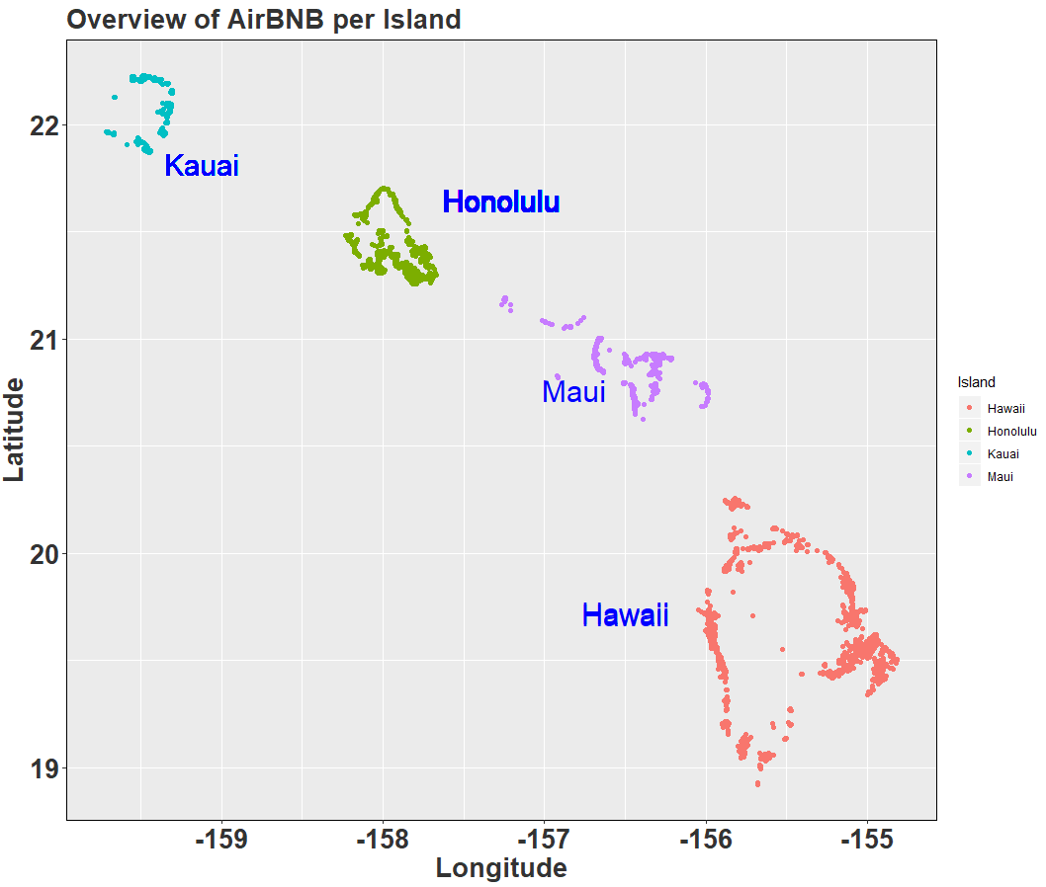
Overview
On the 4 Islands…
17,204 AirBnB’s
Let’s look closer…

Slide 5
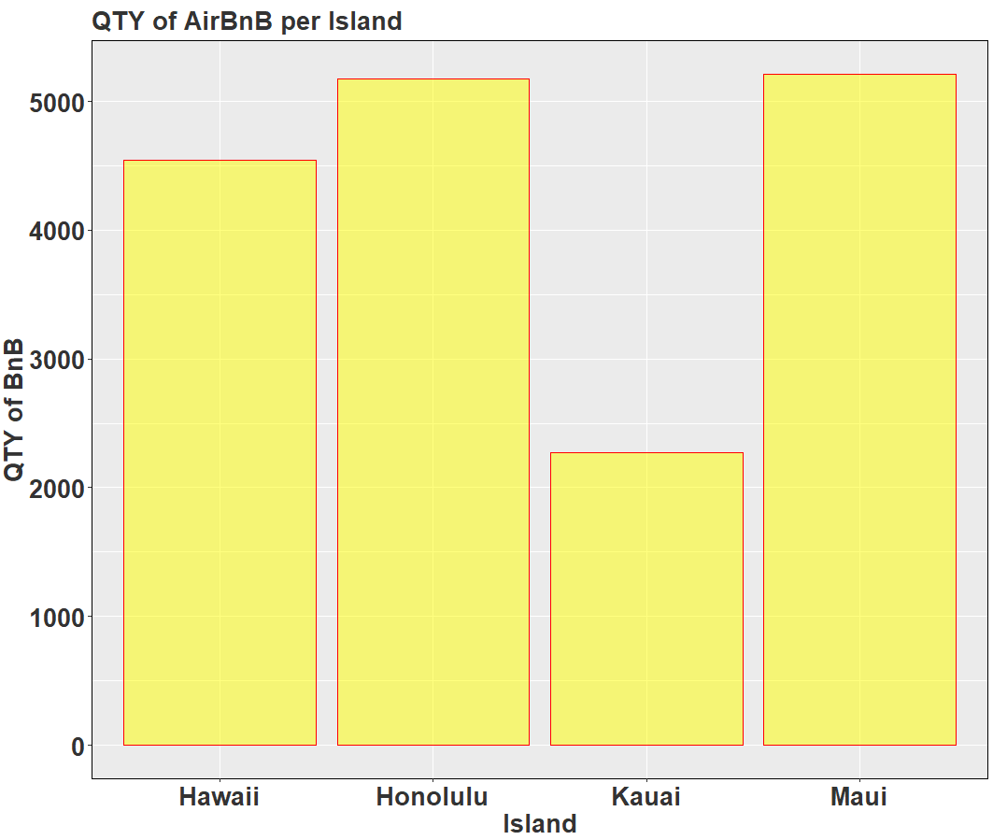
AirBnb per Island
Kaui has fewest
It is a close race between
Other’s
But wait, I want to know
More.
Question:
Who has the great hosts

Slide 6
Question: Who has great hosts

Slide 7
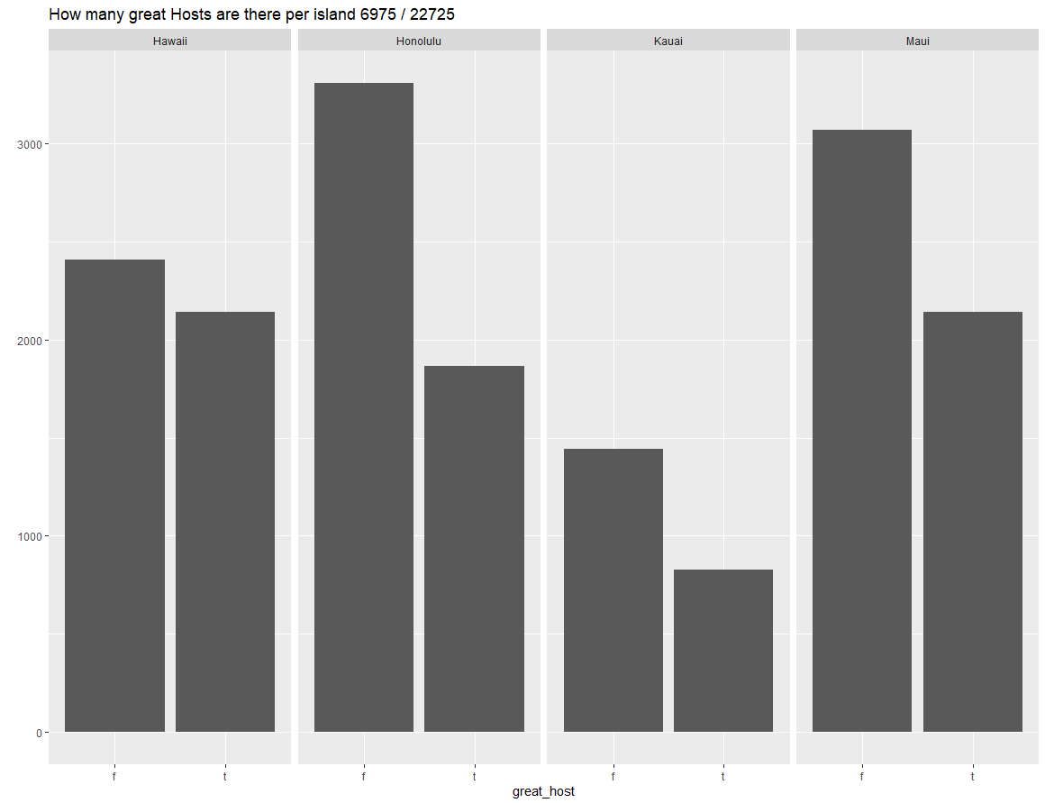
Great Hosts
Hawaii is even with
Maui

Slide 8
Question: How old are AirBnB
But how old are AirBnB

Slide 9
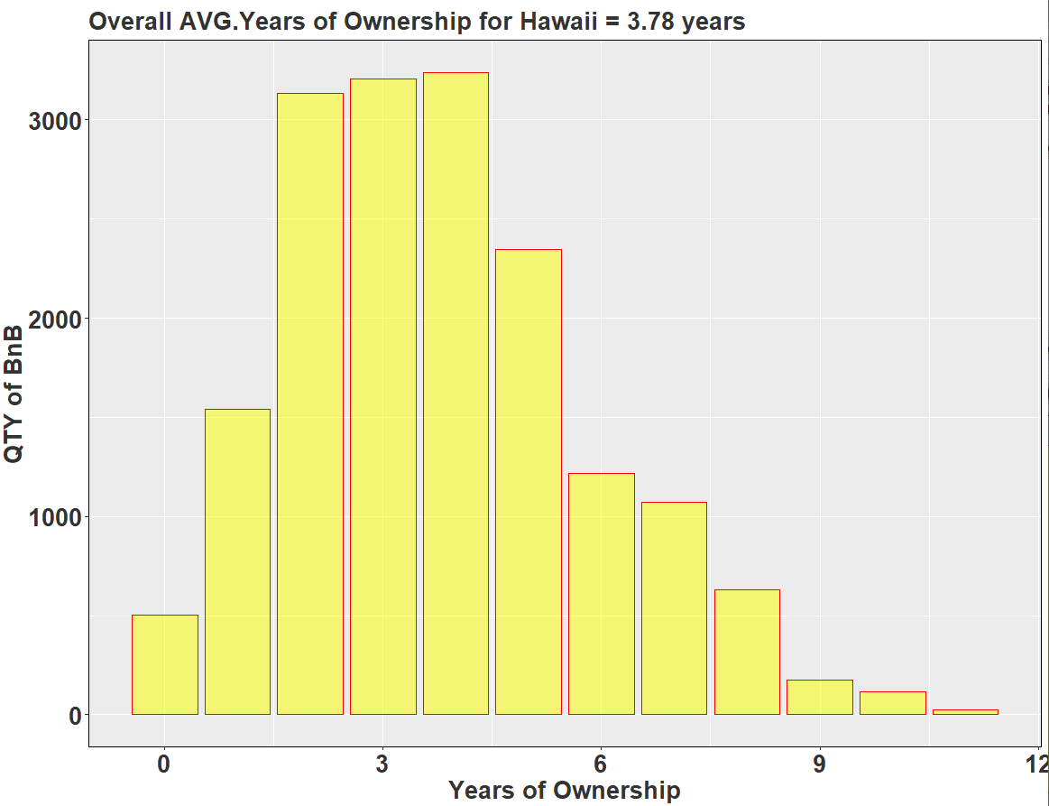
Years of Ownership
Avg. 3.78
Considering all
islands

Slide 10
I think we need a Bar chart for ownership per island

Slide 11
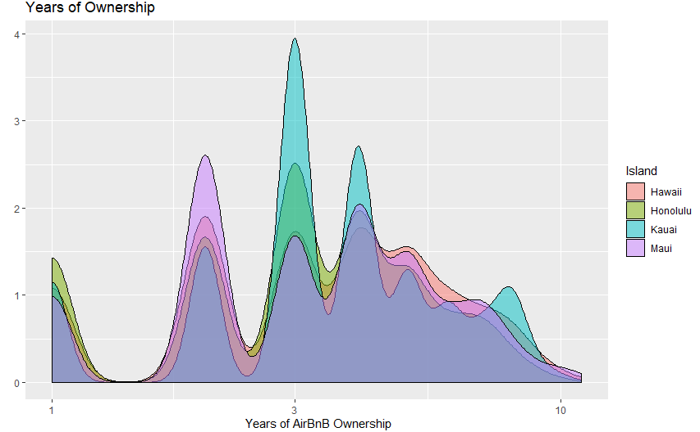
Years of Ownership

Slide 12
Price

Slide 13
Break it down by Hawaii

Slide 14
Break it down by Hawaii by east/west

